Slide 1
Working and analysis of sorting algorithms
Anusha Komarlu Pradeep Kumar
1002082930

Slide 2
Agenda
Insertion Sort
Merge Sort
Quicksort
Heapsort
Radixsort
Running time with different data sizes.

Slide 3
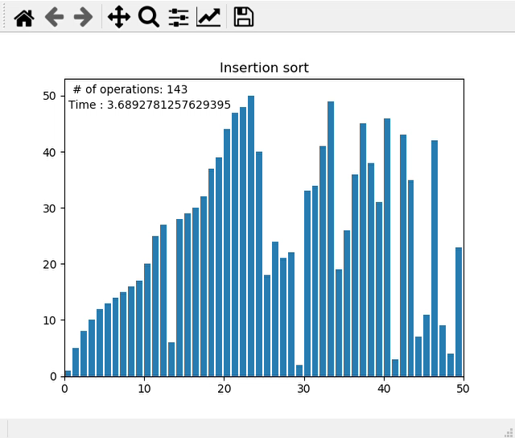
Insertion Sort
Insertion sort is a simple sorting algorithm that builds the final sorted array (or list) one item at a time by comparisons.
Better to use when :
Data is already sorted (or nearly sorted).
Space efficiency is preferred over time.
Stable sorting is required (relative order is important).
The dataset to be operated is of small size.
The in-place algorithm is needed.
 | Time complexity Best Case | Time complexity Average Case | Time complexity Worst Case | Space complexity
Insertion sort | O(n) | O(n²) | O(n²) | O(1)

Slide 4
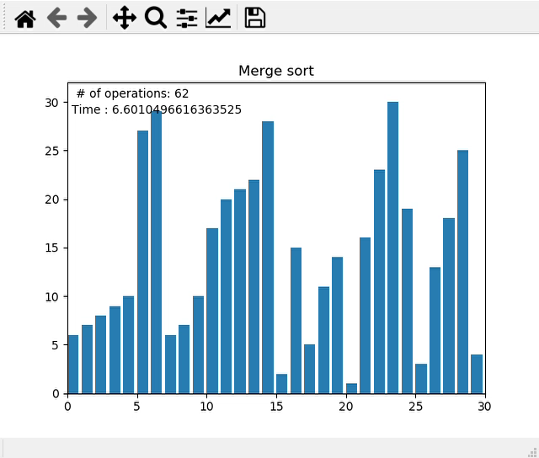
Merge Sort
The Merge Sort algorithm is a sorting algorithm that is based on the Divide and Conquer paradigm. In this algorithm, the array is initially divided into two equal halves and then they are combined in a sorted manner.
Better to use when :
The dataset to be sorted is large (also useful in Linked List sorting).
We need a faster algorithm (time is a major constraint).
Memory overhead is not a big issue.
Stability of data is needed with faster implementation.
External Sorting method with the poor locality of reference is not an issue.
 | Time complexity Best Case | Time complexity Average Case | Time complexity Worst Case | Space complexity
Merge sort | O(nlogn) | O(nlogn) | O(nlogn) | O(n)

Slide 5
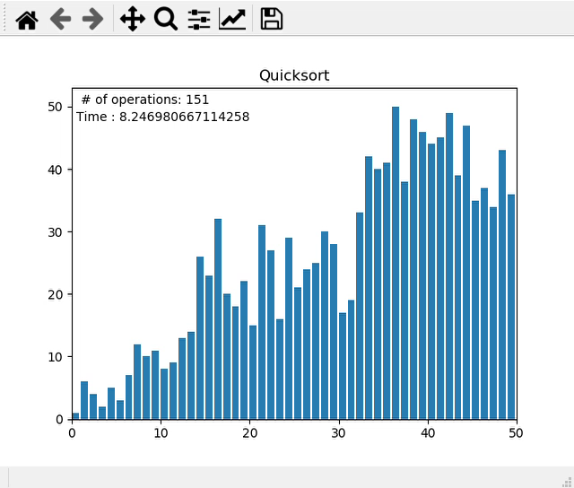
Quick Sort
Quicksort is a divide-and-conquer algorithm. It works by selecting a 'pivot' element from the array and partitioning the other elements into two sub-arrays, according to whether they are less than or greater than the pivot.
Better to use when :
We need a faster sorting algorithm with a good locality of reference.
Internal sorting method is preferred.
Extra memory is a constraint.
The dataset size is not very big.
Stability is not an issue (relative order is not important).
 | Time complexity Best Case | Time complexity Average Case | Time complexity Worst Case | Space complexity
Quick sort | Ω(nlogn) | θ(nlogn) | O(n²) | O(logn)

Slide 6
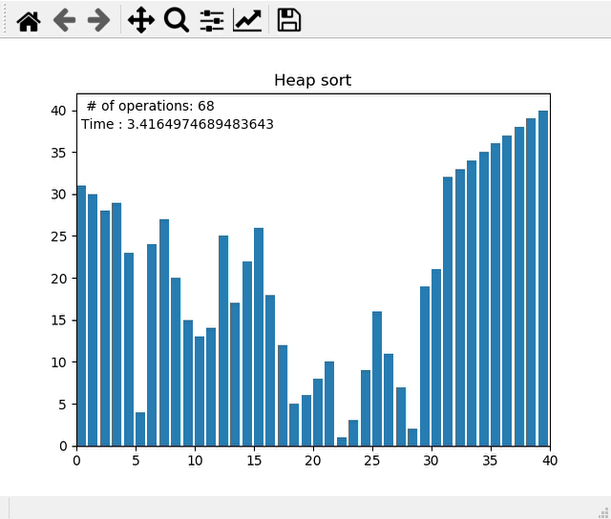
Heap Sort
Heapsort is the in-place sorting algorithm. The concept of heap sort is to eliminate the elements one by one from the heap part of the list, and then insert them into the sorted part of the list.
Better to use when :
We need extreme elements very fast.
We need a partially sorted array (if execution stopped abruptly).
We need to avoid quicksort worst case.
Stability is not an issue (relative order is not important).
Memory complexity (extra space) is an issue.
 | Time complexity Best Case | Time complexity Average Case | Time complexity Worst Case | Space complexity
Heap sort | Ω(nlogn) | θ(nlogn) | O(nlogn) | O(1)

Slide 7
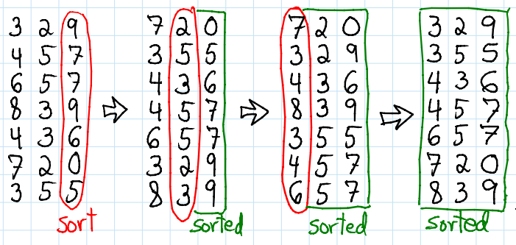
Radix Sort
The idea of Radix Sort is to do digit-by-digit sort starting from the least significant digit to the most significant digit.
Better to use when :
The biggest integer is shorter than array size.
We have fixed range of integers.
Numbers are not much repeated but their length have same range.
Stability of data is needed with faster implementation.
 | Time complexity Best Case | Time complexity Average Case | Time complexity Worst Case | Space complexity
Radix sort | Ω(N k) | θ(N k) | O(N k) | O(N +k)

Slide 8

Running time with different data sizes
Algorithm | 100 | 1K | 10K
Insertion sort | 0.0273 | 0.4121 | 12.8598
Merge sort | 0.00134 | 0.0180 | 0.21675
Quick sort | 0.00129 | 0.0082 | 0.0632
Heap sort | 0.00268 | 0.221286 | 0.4457
Radix sort | 0.00214 | 0.0080 | 0.0952

Slide 9
Thank you

